Slide 1

2026
Presentation
Deck Template

Slide 2
Welcome
This template contains everything you need to create a variety of presentations and decks that follow our 2026 brand guidelines.
You can use this template as a starter for your own documents, removing, duplicating, and editing the slides as required.

Slide 3
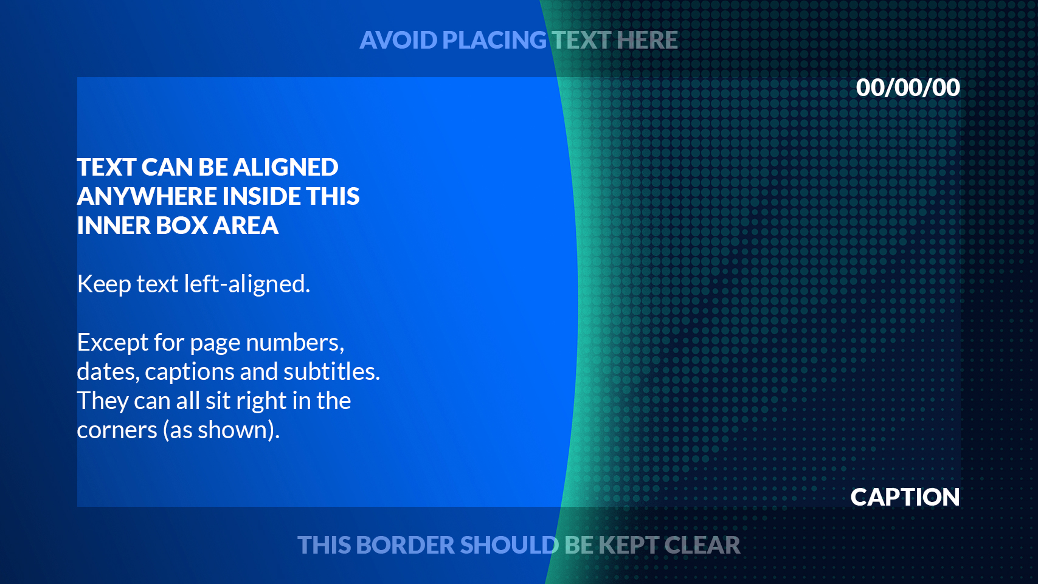

Slide 4
General Advice
If you stick to the colours and fonts outlined in our brand guidelines (the ones used in this template) you can’t go too far wrong.
Be careful not to overcrowd a slide with too much information. It hurts readability and looks sloppy.
Another thing to watch out for are orphans.
Like the italicized example above, an orphan is single word that drops down at the end of a paragraph.
Never forget, the primary purpose of a good presentation is to convey information, clearly and concisely.
Think about the goal of each individual slide and decide how best to achieve that goal.
To help you, the rest of this deck contains a variety of layouts and designs you can use and modify.
Let’s get started!

Slide 5
TEMPLATE
SLIDES

Slide 6
Date
Title Card 01
(Volume logo)
Subtitle (if needed)

Slide 7

Date
Title Card 02
(no logo)
Subtitle (if needed)

Slide 8
NEW
SECTION 01

Slide 9
NEW
SECTION 02
Subsection
Page number

Slide 10

Image Slide 01
Use this slide if you have a large image you want to talk about. Any text should fit within this narrow column.

Slide 11
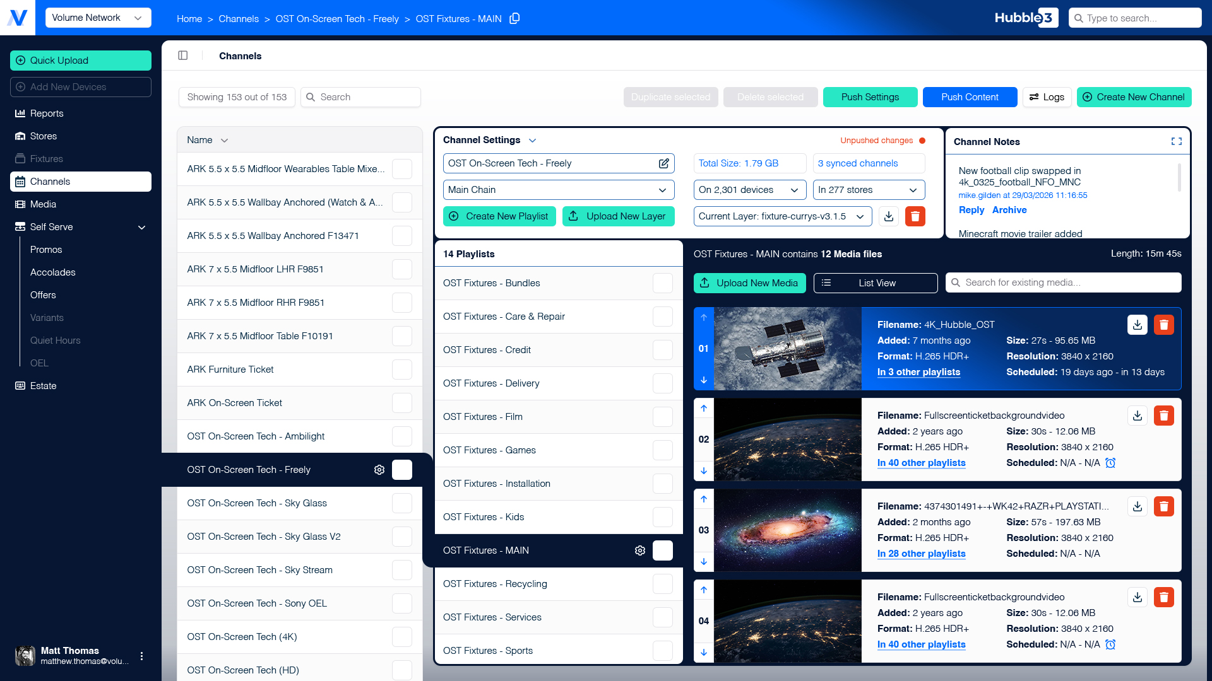
Image Slide 02
If you have a screenshot, it’ll likely be 16:9 aspect ratio.
Note that we don’t use drop shadows or outlines on screenshots.
But an image can overlap with the border, unlike text.
Caption or credit

Slide 12
Image Slide 03
Obviously, you can completely fill a slide with an image.
Just make sure it’s not being stretched.
Cropping the image is okay, provided no important context is lost off the edge.

Slide 13
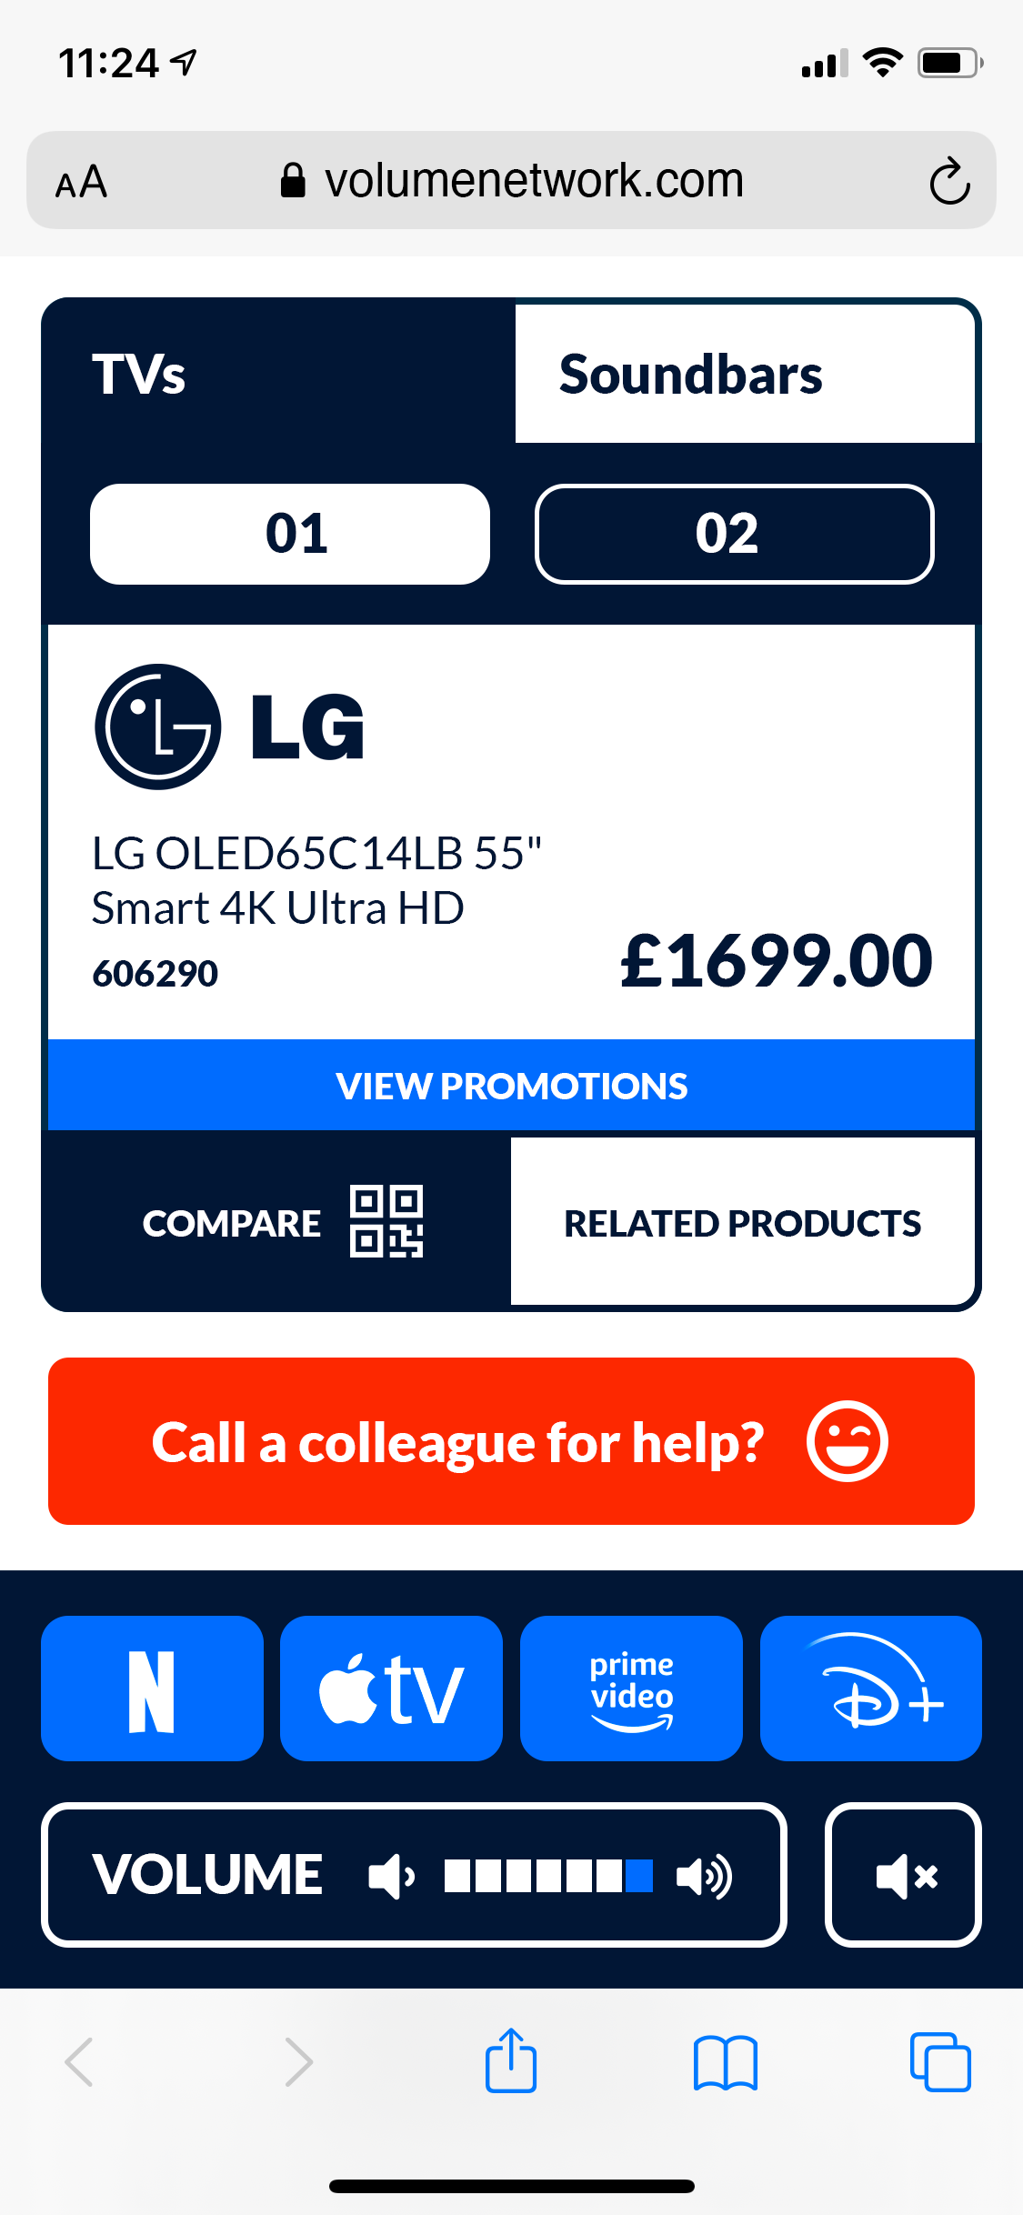
Image Slide 04
Stick to a single screenshot if you want to add labels.
For portrait device screenshots, you can extend the blue panel and center up to three images.
But if you’re only showing one screenshot, there’s plenty of space for labels and notes.
Align your label to the screenshot
Place any text carefully to avoid the need for arrows

Slide 14
Image Slide 05
The background shape can be adjusted to hide the sharp corners of any screenshot you’d like to frame.
Opaque background
Transparent example

Slide 15
Image Slide 06
If you need to fit more than three mobile screenshots on a slide, consider grouping them over multiple slides instead for clarity.
Please note, if using page numbers, omit them on this slide.
Caption or credit
Caption or credit
Caption or credit

Slide 16
Columns 01
Elaborate Here
This is a very generic layout that can be used for a wide variety of information.
State the broader idea here, off to the side, then…
This single column is also big enough to fit tables or images.

Slide 17

Columns 02
Columns 02
Useful for comparing two options.
Lists work well with this layout
So do timelines and roadmaps
Though we prefer bullet points
As they’re simpler than numbers
Save numbered lists for when you have subsections and detail
You can also use Volume Navy but avoid using Green as a background colour. Never use Safety Orange.

Slide 18
Columns 03
Green Title
Blue Title
White text on Volume Blue
White text on Volume Navy
Volume Navy text, white background

Slide 19
Table Slide
Subsection
Page number

Slide 20
Timeline Slide
Subsection
Label 01
Label 03
Label 05
Highlighted
Label 04
Page number

